Slide 1
WEEK 3
Text Structures and Tags

Slide 2
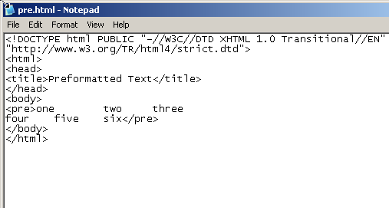
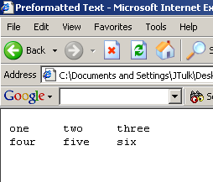
PREFORMATTED TEXT
Whitespace that is maintained when viewed in a browser. (Usually displayed in a Courier font.)
The Space key has been pressed between each number and the Enter key has been pressed after “three”.

Slide 3
STRUCTURAL ELEMENTS
The <body>…</body> section of an HTML document is assumed to be largely made up of text structures such paragraphs, heading and lists
HTML includes a (limited) range of tags to identify and render these structures
These tags are all containers
Containers can sometimes be legally nested (one container completely inside another) but …
Containers can never be ‘crossed’

Slide 4

<h1>This is <em>a</em> heading</h1>

<h1>This is <p>a</p> heading</h1>

<p>This is <p>a</p> normal paragraph</p>

<p>This is <strong>a</strong> normal paragraph</p>

<p>This is <strong>a normal paragraph</p></strong>

Slide 5
PARAGRAPHS AND LINE BREAKS
The basic text structure is the paragraph break (or just paragraph)
The paragraph break container <p>…</p> cannot contain other structural elements (except the line break <br> and <span>)
The browser interprets the paragraph tag by inserting a blank line (‘whitespace’) and starting a new paragraph on a new line

Slide 6
PARAGRAPHS AND LINE BREAKS
The line break tag <br> is not a standard container, but is made into one in XHMTL as <br /> {note the space!} (both <br /> and <br> are valid in HTML5)
A line break starts a new line, but without the white space of a paragraph break
The horizontal rule <hr> can be used to create a separator. Like the line break, it is also ‘closed’ in XHTML with <hr /> (both <hr /> and <hr> are valid in HTML5)

Slide 7
HEADINGS
HTML supports six levels of heading: <h1>…</h1> through to <h6>…</h6>
The browser uses variations in font size and weight to create a suitable visible gradation from ‘biggest’ to ‘smallest’

Slide 8
LISTS
HTML has three basic list structures:
  the unordered (or ‘bullet’) list
  the order (or numbered) list
  the description list
Ordered and unordered lists have the same structure
  an ‘outer’ container that defines the list type: <ol>…</ol> for an ordered list and <ul>…</ul> for unordered
  a number of list items containers <li>….</li>, one for each line in the list

Slide 9
DIVISION
Allows the grouping of other elements
With the style attribute, can be used to control the position of sets of elements
<div style=“text-align:right”>
<p>This paragraph will be right-aligned</p>
<h2>So will this heading</h2>
<p style=“text-align:center”>But this ‘local’ style over-rides the division, so this paragraph will be centred within the screen area.</p>
</div>

Slide 10
SPAN
A container that is (mainly) used to apply style properties to text within another element (such as headings or paragraphs)
Its attributes are all about identification, so must use styles to set appearance
May also be used ‘empty’ - as can the <div> container – to “apply” scripts to page content
<h1>Part of the text in this heading is rendered in <span style=“font-style:italic”>italics</span> by using a span.</h1>

Slide 11
SPECIAL CHARACTERS
You cannot include characters such as < and > in text within a HTML document because the browser tries to interpret it as a command. Therefore you need to use escape codes.
  &lt; <
  &gt; >
  &nbsp; non-breaking space

Slide 12
TEXT APPEARANCE
Until the advent of styles (which will be examined in detail in later sessions) HTML had very limited control of text format (display)
  simple physical (presentational) formatting such as <i>…</i> and <b>…</b>
  better, logical (informational) formatting such as <em>…</em> and <strong>…</strong>

Slide 13
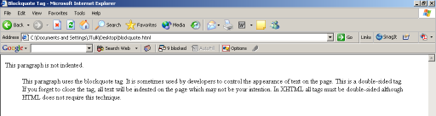
<BLOCKQUOTE>
Used to create quotations or for layout.

Slide 14
<IMG>
HTML supports embedded images through the <img> tag (in XHTML it is made into a container by adding the space/ combination <img />)
primary attribute is src, which (like the href in links) is either
  a filename (image in the same directory as the HTML page)
  a filename with relative path (image in a different directory), or
  a full URL (image on another server)

Slide 15
<IMG>
<img src=“prettypix.jpg”>
<img src=“../people/friends/prettypix.jpg”>
<img src=“http://www.strange.com/friends/prettypix.jpg”>

Slide 16
<IMG>
image formats are a (potential) problem
  only bitmaps can be used
  vector graphics (line drawings) need to be handled through plugins, or converted to bitmap form
  no particular format is mandated
  GIF and JPEG are widely supported, PNG (Portable Network Graphic format) less so
  Windows (or Mac) ‘native’ formats may not work

Slide 17
<IMG>
each image is sent as a separate file, so the width and height attributes should be included
  lets the browser lay out the page whilst images continue to arrive
  otherwise, page is basically blank until all content has reached the client
  these values should not be used to ‘thumbnail’ lots of images on a page by sending the same file, but giving small values for width and height!

Slide 18
<IMG>
the title attribute: a text message that appears when mouse hovers over image
the alt attribute: this message is all that a user without graphics support (using a text browser, or a graphical browser with image display turned off) will see
  it also a very important aspect of page accessibility: making pages accessible to users who have ‘problems’ with seeing pages, perhaps through a disability

Slide 19
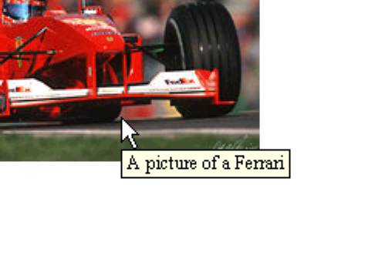
ALT ATTRIBUTE (ALTERNATIVE)
<img src="ferrari.jpg" alt="A picture of a Ferrari">

Slide 20
LINKS
<a href=“http://www.grandprix.com”>
<img src=“ferrari.jpg” /></a>
Image will become a link.
Has a border around it to indicate the link.
  If you do not want a border use the attribute border=“0”

Slide 21
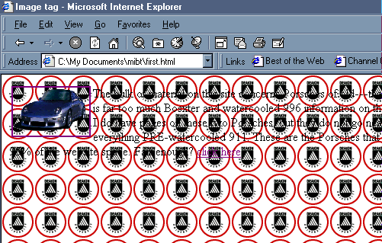
IMAGE BACKGROUNDS
Images that tile in the background of your pages
<body
style=background-image:url("logo.gif")>

